Slide 1
Savannah State University Title IX Office of Compliance
Flora Devine, Esq. University Counsel and Title IX Coordinator
Bonita Bradley, AVP & Dean of Students, Deputy Coordinator
Jazmyn Knight, JD, EEO Coordinator & Title IX Investigator

Slide 2
What is Title IX?
No person in the United States shall, on the basis of sex, be excluded from participation in, be denied the benefits of, or be subjected to discrimination under any education program or activity receiving federal financial assistance.
(Title IX of the Education Amendments of 1972)
Title IX applies to all members of the Savannah State University community, not just students.

Slide 3
What Does This Mean?
We (SSU) must ensure a safe and secure academic, residential and work environment so all can fully participate

Slide 4
Sexual Harassment (Student on Student)
Unwelcome verbal, nonverbal, or physical conduct based on sex (including gender stereotypes) determined by a Reasonable Person to be so severe, pervasive, and objectively offensive that it effectively denies a person equal access to participate in or to benefit from an institutional education program or activity.

Slide 5
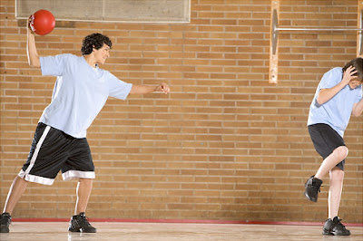
Examples of unlawful harassment
Verbal conduct such as epithets, derogatory jokes or comments, slurs or unwanted sexual advances, invitations or comments.
Visual conduct such as derogatory and/or sexually oriented posters, photography, cartoons, drawings, e-mail and faxes or gestures.
Physical conduct such as assault, unwanted touching, blocking normal movement or interfering with work directed at an employee because of the employee’s sex or other protected characteristic.
Threats and demands to submit to sexual requests in order to keep one’s job or avoid some other loss, and offers of employment benefits in return for sexual favors.
Retaliation for having reported or threatened to report unlawful harassment.

Slide 6
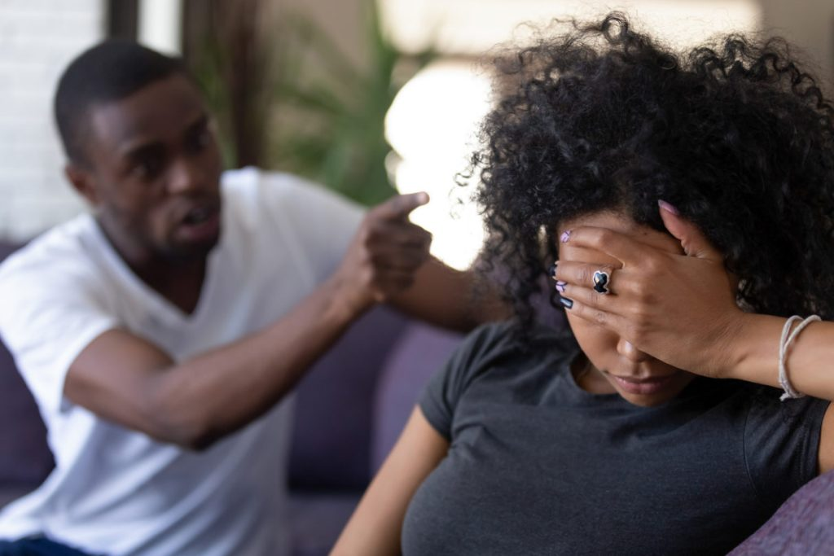
Key Categories of Prohibited Conduct
Dating Violence – Violence by a person who is or has been in a romantic or intimate relationship.
Domestic Violence—Violence by a current or former spouse or intimate partner, co-parent, living partner, youth, or other under state law.
This Photo by Unknown Author is licensed under CC BY-ND

Slide 7
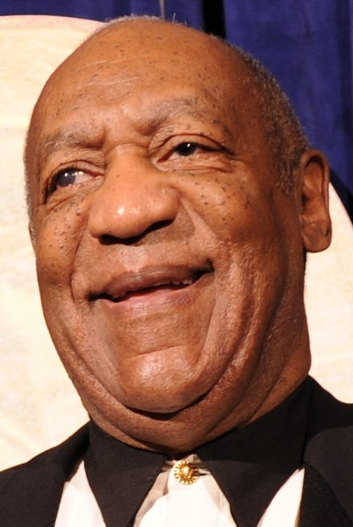
Prohibited Conduct cont’d
Sexual Assault – A forcible or non-forcible sex offense (Non-consensual sexual contact and non-consensual sexual penetration).
Sexual assaults consist of any sexual act directed against another person, without
the consent of the victim, including instances where the victim is incapable of giving consent.
Rape
Attempted Rape
Sodomy
Fondling
Statutory Rape

Slide 8
Prohibited Conduct Cont’d
Stalking – Engaging in a course of conduct directed at a specific person that would cause a reasonable person to fear for their safety or the safety of others or suffer substantial emotional distress.
Sexual Exploitation – Taking non-consensual or abusive sexual advantage of another for one’s own advantage or benefit or for the benefit or advantage of anyone other the one being exploited.
Invasion of sexual privacy.
Prostituting another individual.
Non-consensual photos, video, or audio of sexual activity.
Non-consensual distribution of photo, video, or audio of sexual activity, even if the sexual activity or capturing of their activity was consensual;
Intentional observation of nonconsenting individuals who are partially undressed, naked, or engaged in sexual acts;
Knowingly transmitting an STD or HIV to another individual through sexual activity;
Intentionally and inappropriately exposing one’s breasts, buttocks, groin, or genitals in non-consensual circumstances; and/or
Sexually-based bullying

Slide 9
Other Changes in Title IX Regulations in 2020
Informal Resolution
Formal Investigation Process
An Advisor of Choice for both parties:
~Attorney
~Advocate
~Parent/Guardian
~Friend
~Witness

Slide 10
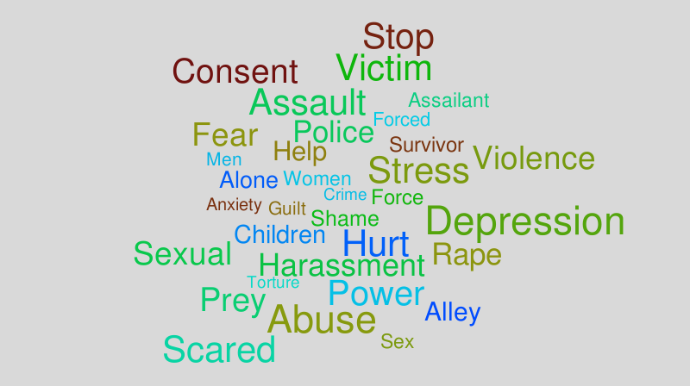
Campus and Community Resources
SSU Department of Public Safety
Hubert Tech Science-Building C-Rooms 309/305 (912-358-3004)
Office of Counseling and Disability Services
King Frazier Complex, Room 233 (912-358-3129)
Harris-McDew Student Health Center
Jasmine Avenue adjacent to Payne Hall (912-358-4122)
Savannah Police Department
(912-652-6500) (non-emergency number)
Mary’s House—Rape Crisis Center of Savannah
(912-233-3000)

Slide 11
Title IX Office of Compliance
Colston Building, Suite 205 (2nd Floor)
912-358-4055
Email:
TitleIXReporting@savannahstate.edu

Slide 12
Building a “Consent” Culture at SSU
Consent is:
CLEAR
COHERENT
WILLING
ONGOING
This Photo by Unknown Author is licensed under CC BY-SA

Slide 13
CLEAR: Consent is Active
It is expressed through words or actions that create mutually understandable permission.
Consent is never implied, and the absence of a no is not a yes.
Silence is NOT consent.
“I’m not sure,” “I don’t know,” “Maybe”, and other phrases are NOT consent

Slide 14
COHERENT: People incapacitated by drugs or alcohol cannot consent.
Someone who cannot make rational, reasonable decisions because she or he lacks the capacity to understand the “who, what, when, where, why or how,” of the situation cannot consent.
People who are asleep or in another vulnerable position cannot consent.

Slide 15
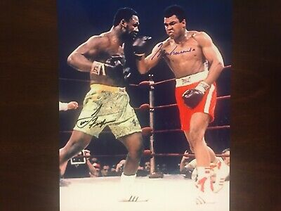
WILLING: Consent is never given under pressure.
Consent is not obtained through psychological or emotional manipulation.
Consent cannot be obtained through physical violence or threat.
Someone in an unbalanced power situation (i.e., someone under your authority) cannot consent.

Slide 16
ONGOING: Consent must be granted at every step.
Consent must be obtained at each step of physical intimacy. If someone consents to one sexual activity, she or he may or may not be willing to go further.

Slide 17
What’s Next?
Campus Title IX Training
Faculty and Staff
~Investigator Training
~Advocate Training
~Hearing Panelist Training
~Sexual Harassment Prevention
Student Training
~Sexual Misconduct and Sexual Harassment Prevention
~Bystander Training
~Advocate Training

Slide 18
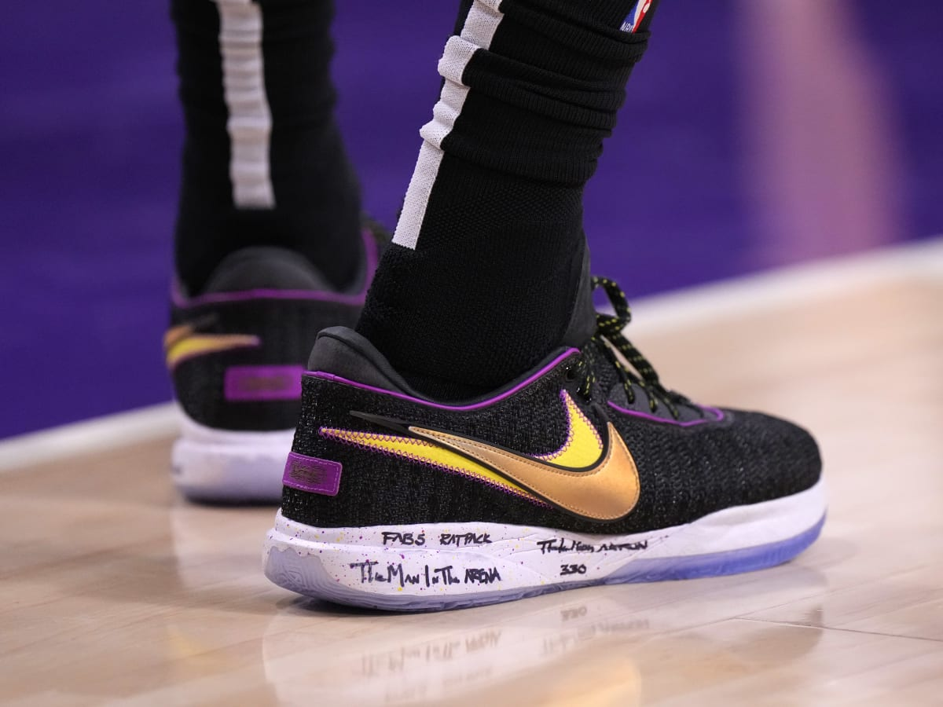
“The Man in the Arena”

Slide 19
“MAN IN THE ARENA”
“It is not the critic who counts; not the man or woman who points out how the strong man or woman stumbles, or where the doer of deeds could have done them better.
The credit belongs to the woman or man who is actually in the arena, whose face is marred by dust and sweat and blood; who strives valiantly;
…who at the best knows in the end the triumph of high achievement, and who at the worst, if she/he fails, at least fails while
daring greatly.” (Theodore Roosevelt, 1910)

Slide 20
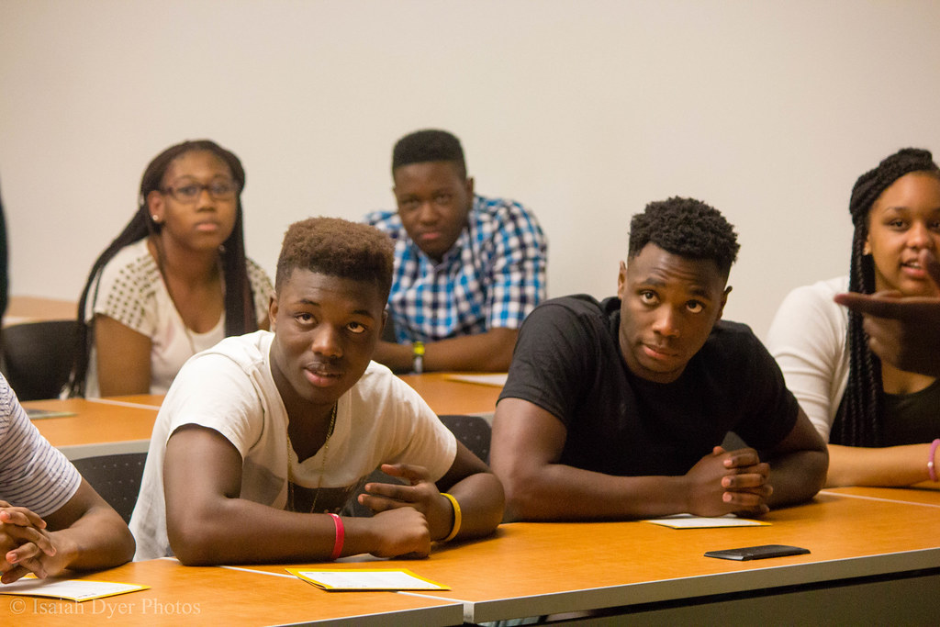
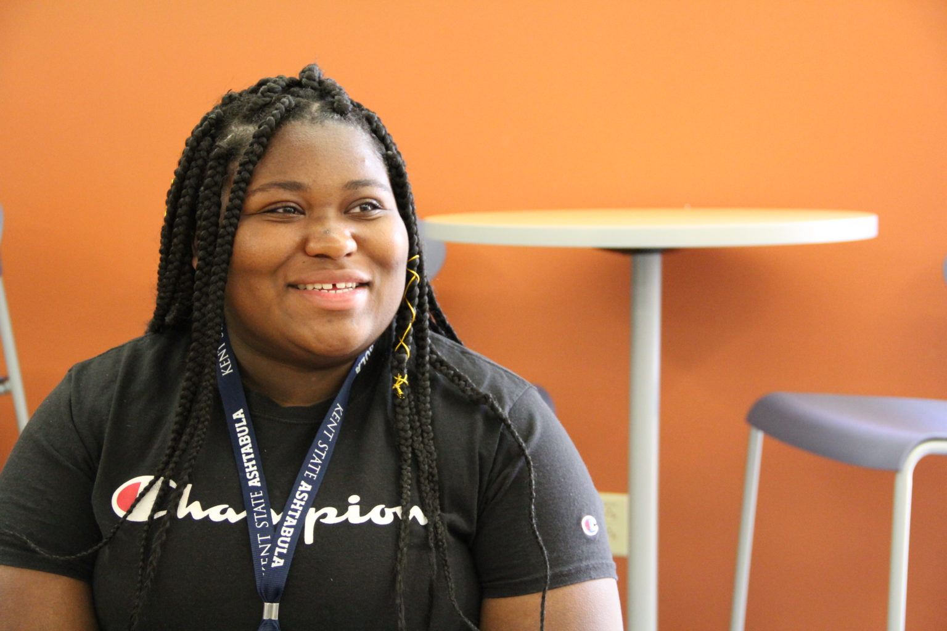
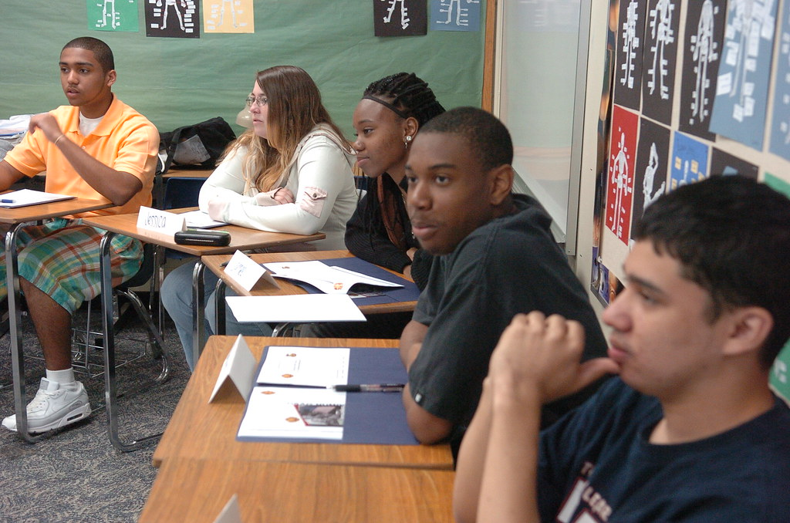
SSU Title IX Consent Educators
“Men in the Arena”
and
“Women in the Arena”

Slide 21
Rising Strong at SSU: Men and Women in the Arena

Slide 22
Sexual Consent on Campus: Can Education Help Prevent Sex Assault Among College Students?

Slide 23
“MAN/WOMAN IN THE ARENA” CONSENT EDUCATORS
 | Volunteer Name | Phone (Home) | Phone (Cell) | Email
1.
2.
3.
4.
5.
6.
7.
8.
9.
10.
11.
12.
13.
14.
15.

