Slide 1
How Easy is it to Self-Publish, After All?
The Facts and the Fiction!
Trelani Duncan

Slide 2
Fiction
Work of literature that takes the reader into an imaginary world
Can be totally made-up or semi-true
Various genres (sci-fi, historical fiction, contemporary women’s fiction, chick lit, fantasy, mystery, thriller, erotica, etc.)

Slide 3
Fiction Toolbox
Plot
Characterization
Setting
POV
Theme
Style

Slide 4
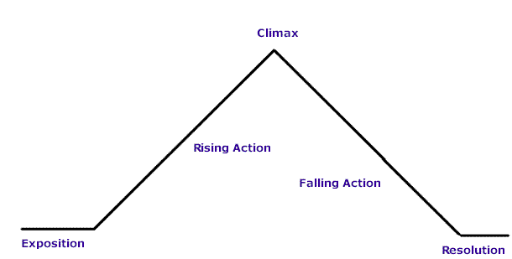
Plot
The sequence of events in a story
Every action or dialogue must help to move the plot along

Slide 5
Characterization
Important figures in literature
People, animals, spirits, objects, etc.
Well-developed characters vs. flat characters
Goals, habits, flaws, preferences, distinctness
Primary, secondary, tertiary

Slide 6
Exercise #1
Two people are walking down the street together, holding hands. Everyone that they pass stops and stares.
Describe these two people.

Slide 7
Setting
Is what takes the reader “there”: location, time, and general background of the story
General setting vs. specific setting

Slide 8
Exercise #2
Use the same two characters from the previous exercise.
Describe the setting.

Slide 9
POV
The point of view from which the story is being told
First person (I, me)
Second person (you)
Third person (he, she)
Be consistent

Slide 10
Theme
Moral of the story
The lesson learned
Usually not explicitly stated, but inferred

Slide 11
Style
What separates you from other writers
The words you choose, the way that you arrange them and use them
For example, though both are black men that wrote in the same era, Richard Wright does not write like W.E.B Du Bois.
“Style is to forget all styles.”
—Jules Renard

Slide 12
Becoming an Author
Read everyday.
“If you don’t have time to read, you don’t have the time (or tools) to write. Simple as that.” –Stephen King
Read as a writer.
What did you like (or dislike) about the book? Why?
Write everyday.
Keep a journal
Blog
Work on your book daily, set reasonable goals

Slide 13
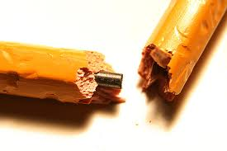
Common Challenges
Writer’s block
Perceived lack of time
Perceived lack of money
Perceived lack of skill

Slide 14
Writer’s Block
Solutions:
Take a break
Change your environment
Go for a walk
Use a prompt

Slide 15
Lack of Time
Commit
Schedule your day
Start off writing for ten minutes per day
Sacrifice social media and television

Slide 16
Lack of Money
Cost nothing to write
Budget
Work with what you have
Online stock images/photo editors
Hire a friend (or friend of a friend)
Begin with e-readers until you can afford to print
Start slow, no rush

Slide 17
Lack of Skill
Practice!
Use your resources.
Read like a writer.
Find a friend.
Hire an editor.
**The book that you see on bookshelves are not the first drafts**

Slide 18
Publishing
Write the book.
Publish the book.
Way of getting your book to the masses.
Two options:
Traditional publishing
Self-publishing

Slide 19
Traditional Publishing
Find an agent
Send your manuscript and query letter
Sort through rejections
Wait for acceptance
Hope for a good contract
Wait on royalty check

Slide 20
Self-Publishing
Do everything that the traditional publisher does, on your own.
Write the book.
Get the book edited.
Layout and cover design.
ISBN
Copyright/Library of Congress
Print
Promote

Slide 21
Editor
Always hire a professional editor
Not you, your mom, your professor, or best friend
Three levels of the editing phase
Copyediting: spelling, grammar, and punctuation
Developmental: plot structure, believability, story flow. Clear beginning, middle, and ending? Well-developed characters? Etc.
Proofread: final read/edit before book goes to print

Slide 22
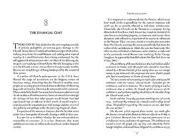
Layout/Cover Design

Slide 23
ISBN/Copyright
ISBN = your book’s SSN
Copyright your book and its title through the Library of Congress
Library of Congress Control Number (LCCN)

Slide 24
Print
Choose your book size, layout, binding, etc.
Choose a printer (price varies)
Examples: CreateSpace, Alphagraphics, Lightning Source, BooksbyBooks, etc.
Format for e-readers and upload (free)
Examples: Kindle, Nook, iBooks, Kobo, Sony, etc.

Slide 25
Promote
Write the book.
Publish the book.
Promote the book:
Book launching party
Participate in events as a vendor
Website and social media
Guest-blog
Media kit
Book reviewers and book clubs

