Slide 1
Travel Training FY 2018
Office of Business and Financial Affairs
Savannah State University

Slide 2
Purpose
The purpose of this policy is to provide guidelines to state agencies for payment of travel expenses in an efficient, cost effective manner, and to enable state travelers to successfully execute their travel requirements at the lowest reasonable costs, resulting in the best value for the State.

Slide 3
Travel Website
http://www.savannahstate.edu/fiscal-affairs/universitytravel.shtml

Slide 4
Familiarize yourself with the new Travel Regulations from the State of Georgia policy via these links.

Slide 5
Pre Travel
Travel Authorizations & Supporting Documentation

Slide 6
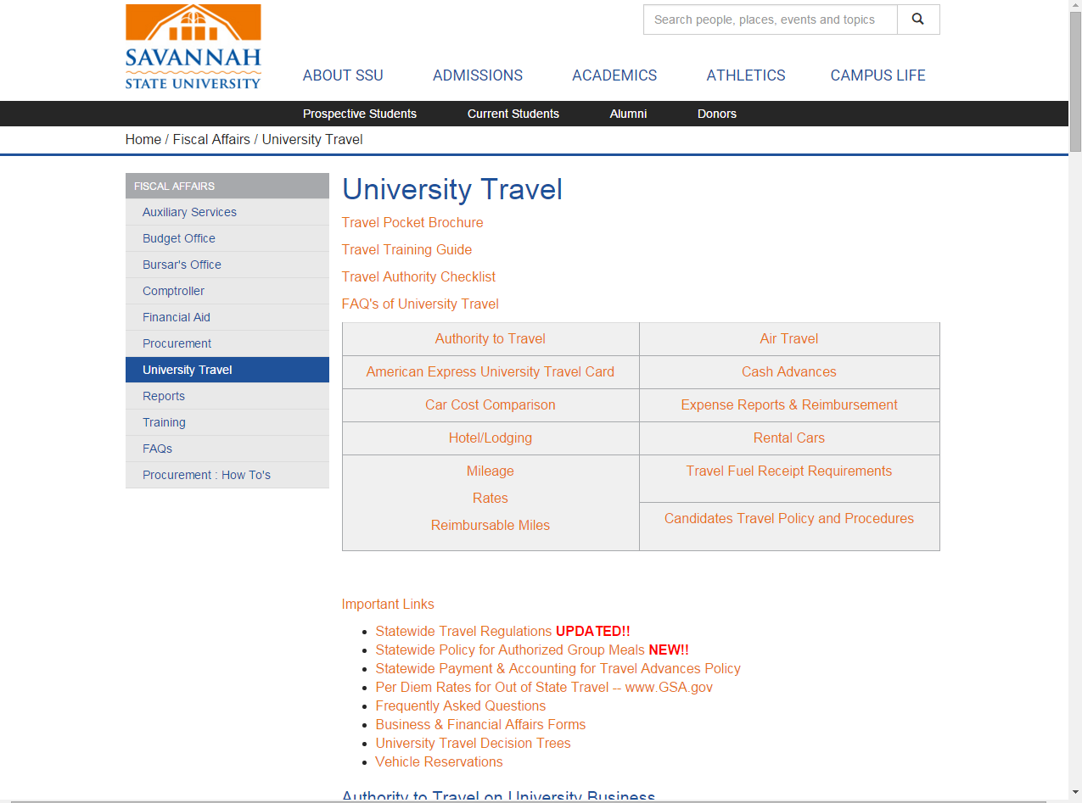
Authority to travel

Slide 7
Click on this link to take you to the Business and Financial Affairs Forms webpage.

Slide 8
University Travel

Slide 9
ECHOSIGN TA FORM

Slide 10
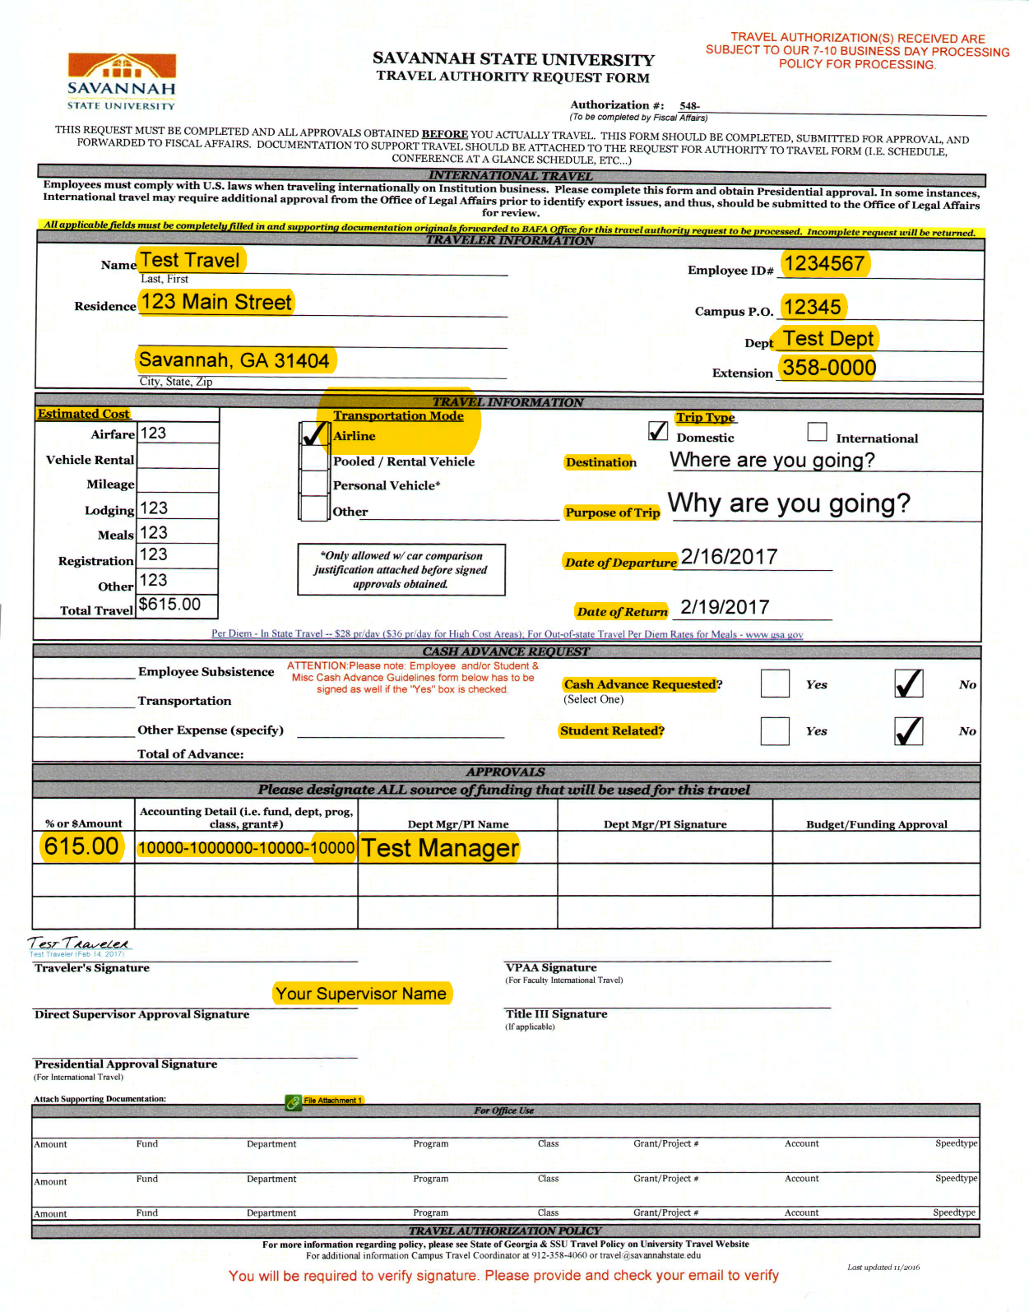
ECHOSIGN TA FORM
EVERYTHING HIGHLIGHTED IS REQUIRED

Slide 11
How to Complete the TA
Complete the first portion of the TA with: complete LEGAL name, off-campus residence, SSU employee identification number, campus P.O, your department and extension.
Complete all field of the expense statement. Every field with a red asterisk is REQUIRED.
Make sure to attach supporting documentation and that every field is completed correctly.
On the last page make sure to sign your name and enter your SSU email address.
Once everything is completed you will be able to submit your TA.
Once we receive your TA, we will then route the form to the appropriate people for signature.
Once we receive all required signatures, we will approve your TA and issue the TA an approval number( This number will be located in red on the top right corner of the TA.)
A digital copy of the approved TA will be returned to the traveler via email, original is kept with the Campus Travel Coordinator.
Approved items may be purchased.
Only items authorized on the TA will be reimbursed.

Slide 12
Approval and Authorization
Approved travel authority is required for all travel outside of a 50 mile radius of SSU.
No TA is required if traveling within 50 miles of the University unless cost is associated with travel.(registration and mileage)

Slide 13
The travelers and approvers agree, by signature, to abide by the University Regulations.
International travel must be approved by the President's Office (additionally if traveler is a member of the faculty, the VP for Academic Affairs must approve international travel as well). Also, US travel to offshore locations (i.e. Hawaii and Alaska) should also be approved by the President's Office.

Slide 14
Role of Approvers
Attesting that he/she has thoroughly reviewed each transaction and supporting documentation.
Verifies that all transactions are allowable expenses.
Transactions must be consistent with departmental budgetary and grant guidelines.

Slide 15
ECHOSIGN CHECK REQUEST FORM

Slide 16
Check Request Approval Per Budget
Requests from Agency Accounts are approved by the Budget Office
Requests from Grants are approved by the Grants Office
Requests from State Funds, Auxiliary Funds, Student Activity Funds, Indirect Cost Funds, and Department Sales and Service Funds are approved by the Accounts Payable Office

Slide 17
Check Request Approval Per Budget
Please complete all fields with a red asterisk
Department Charged – Department Name
Chartfields or Speedtype
Agency (Fund, Department and Account Number)
Grant (Project Number and Account Number)
Other (Speedtype and Account Number)
If there is no Speedtype, list the Fund, Program, Class and Department

Slide 18
Check Request Approval Per Budget
Vendor – Name and ID number
If it is a new Vendor, a completed W-9 Form is needed
Description
What is being purchased and why?
Quantity and Price
Please remove any sales tax (the university is tax exempt)
Signatures Needed
The Requestor and the Budget Unit Head of the Department being charged
These must be separate individuals

Slide 19
Cash Advances and Cash Advance Policy
Travel (cash) advance refers to any payment to an employee for travel expenses made prior to the time that expenses will be incurred for a scheduled, future trip
http://www.usg.edu/business_procedures_manual/section4/C1202

Slide 20
Cash Advance Policy
No cash advances will be issued to the following groups:
Any employee that make $50,000 or more a year.
Any requested advance that is below the $100 threshold
Any employee with outstanding cash advance balance(s).

Slide 21
Cash Advances
Must request two weeks in advance.
Cash advances should be requested when submitting the T.A.
Return unused funds to the Bursar’s office.
Once you receive notice that funds are due to the University, you have 10 business days to receipt the money.
Payroll deduction will forfeit your eligibility to receive future advances.
Lodging cost will no long be covered in an advance

Slide 22
Receipts
Original receipts or receipted invoices are required for all travel expenses for which reimbursement is claimed. This includes expenses that are less than $25.

Slide 23
Receipts
Obtain ALL receipts, except when per diem travel allowances are claimed.
Itemized receipts should include:
Name and address of the vendor
Date of service
Description of service
Amount paid for each individual item
Credit card statements are accepted in lieu of actual receipt.
Tape receipts to a 8.5x11 sheet of paper. (No staples)

Slide 24
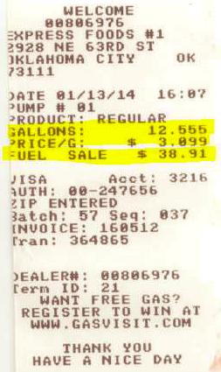
Examples of Receipts

Slide 25
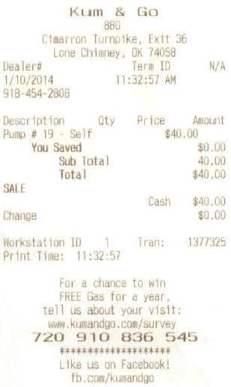
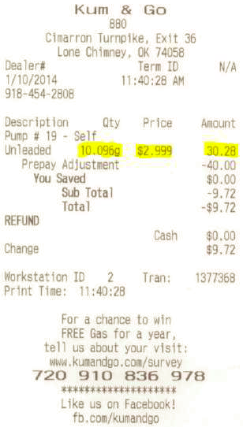
If you prepay with cash.
“Pre-Pay” Receipts are not acceptable. The receipt must have the number of gallons and price per gallon printed in addition to the total amount of the fuel sale. So if you pre-pay with cash, you will have to request and obtain the final receipt, showing the actual fuel sale, including the gallons purchased and price per gallon. As you will notice in the examples above the actual fuel purchase was less than the prepaid amount

Slide 26
Reimbursable Expenses
Business office expenses (copy services, postage, and supplies)
Business related phone calls, faxes, and internet usage charges and fees
Transportation costs from lodging or businesses to restaurants (domestic travel only)
Conference/Registration fees

Slide 27
Reimbursable Expenses
Costs related to passports and travel visas when necessary to accomplish the official business purpose of the trip
Costs related to vaccinations required and/or recommended for international business travel
Currency conversion fees
Baggage handling services, other than regular portage/tips
Laundry.

Slide 28
Non-Reimbursable Expenses
Airline, car, and card membership dues and club fees;
Airline reserved/priority seating fees
Travel upgrade fees (air, rail, car)
Alcoholic beverages
Bank charges for ATM withdrawals, except on international travel
Childcare costs
Clothing or toiletry items
Notes:
More non-reimbursable expenses found in section 5 of State Travel Policy

Slide 29
Non-Reimbursable Expenses
Commuting between Residence and Primary Work Station
Country Club dues
Expenses related to vacation or personal days taken before, during or after a business trip
Haircuts and personal grooming
Laundry, cleaning, pressing costs for trips of less than seven days
Loss Damage Insurance when State agency contract rate vehicle is available and another rental car agency is utilized. (In-state Enterprise; Out of State Enterprise and Hertz)
Notes:
More non-reimbursable expenses found in section 5 of State Travel Policy

Slide 30
Meals
Reimbursable on a per diem basis(NOT actual expenses).
Must be more than 50 miles from the University AND residence.
Must subtract meals provided by host, conference, and/or hotel.
Out-of-State
GSA per diem rate (gsa.gov)
GSA rate includes incidentals, so $5 must be subtracted.

Slide 31
State of Georgia Per Diems
Per Diem for the State of Georgia, is not based off of the GSA rate but was instead determined by the Statewide Travel Policy.
High Cost Areas
Chatham County
Cobb County
DeKalb County
Fulton County
Glynn County
Richmond County

Slide 32
Lodging
Destination must be located more than 50 miles from both their headquarters(work place) AND residence.
Government/Conference rate should be utilized.
Itemized folio hotel receipt must be submitted along with expense statement.

Slide 33
Lodging- Tax Exemption
We are taxed exempt in the State of Georgia.( Sales and Occupancy Taxes).
We are also exempt from paying Florida Sales Taxes.
Exemption forms are found on the University Travel website and must be presented at check-in.
$5 transportation tax(hotel/motel tax) is reimbursable.

Slide 34
Use of Motor Pool, Rental, and Personal Vehicles
A motor pool vehicle should be the first option.
An approved TA is needed to reserve a vehicle online via eReservations.
eReservations website https://simba.savannahstate.edu/forms/transportation/reservation_request.aspx

Slide 35
Derrick Davis Parking and Transportation Manager/ Risk Management X-3111 or davisde@savannahstate.edu http://www.savannahstate.edu/risk/vehicle-training.shtml
The link above will take you to a DOAS video that discusses the Office of Fleet Management and Insurance Coverage.
The ‘yellow’ card, pictured to the right, can be used if a person is driving their personal vehicle for official SSU business.
This card is in all fleet and motor pool vehicles and if an individual is using their personal vehicle, they should use this yellow card as their insurance card, but only if they are performing office job duties.

Slide 36
Use of Motor Pool, Rental, and Personal Vehicles
If a motor pool vehicle is not available a vehicle will be outsourced from Enterprise by Procurement.
If you choose to rent a vehicle, we can only reimburse for Enterprise and Hertz( NO EXCEPTIONS!!!!)
Key rule for rentals: DENY EVERYTHING
Insurance(Only in effect while on official State business)
GPS
Upgrades( Unless free)

Slide 37
Use Personal Vehicles
Least expensive option and no temporary fleet vehicles are available.
Reimbursement rates: (Fuel is not reimbursed)
$0.535 within a 50 mile radius
$0.17 outside of the 50 mile radius
Commute miles must be deducted on normal work days.
Submit Car Cost Comparison with TA and expense statement.
http://ssl.doas.state.ga.us/vehcostcomp/

Slide 38
Air Travel
Must be purchased at least 14 days in advance.
Change in ticket or cancellation of a ticket requires a business justification.
Tickets and quotes should be obtained thorough the following:
Maria at Summit Cruise & Travel at 912-961-0979
Becky or Margaret at Four Seasons at 912-598-8000

Slide 39
Air Travel
Travelers should use nonrefundable fare whenever possible.
Any upgrades will be at the traveler’s expense.
Business and first class tickets are not reimbursable for domestic flights.
First class travel reimbursement is prohibited but business class is allowed for international flights.
The cost of one checked bag is reimbursable ( excluding excess weight baggage).

Slide 40
Combining Personal Travel with State Business Travel
Reimbursement will not exceed the amount of what it would have cost the state if the traveler did not combine personal with business travel.
When combining personal travel and State business travel, baggage and luggage fees should be allocated accordingly, and be reasonable under the circumstances.

Slide 41
The Budget Approval Process
Travel Authorization

Slide 42
TA Approval Per Budget
Documentation Needed:
Location and dates of event
Completed Car Cost Comparison Form (if the Personal Vehicle Box is checked)
Always select “Yes” on question 4
Vehicle Cost Estimate (if the Pooled/Rental Vehicle Box is checked)
Airfare Estimate (if the Airfare Box is checked)
Hotel Confirmation (if applicable)
Registration Form (if applicable)
NOTE: A Travel Authority Form is only for an individual employee’s personal travel expenses

Slide 43
TA Approval Per Budget
Cash Advance Request
Can only be given for meals and miscellaneous costs (parking, baggage fees, rental vehicle fuel)
Airfare and Vehicle Rental can be secured through the Purchasing Department or reimbursed upon return
Mileage Cost for Personal Vehicle Use must be reimbursed because it is calculated based off the actual miles driven on a trip
Registration Cost can be paid by Check Request, P-Card, Purchase Order, or reimbursement upon return from a trip

Slide 44
TA Approval Per Budget
Approval Process
Completed TA signed by the Traveler, Supervisor, and Budget Unit Head is received by the Budget Office
The Budget Analyst or Director checks the TA for all necessary information and documentation
If something is missing, the Budget Analyst or Director will request it from the Traveler (the TA cannot continue processing until all necessary information and documentation is received)
The Budget Analyst or Director checks the available funds of the department being charged
If enough funds are available, the TA is approved and sent to the Reception Desk where the TA number is assigned
If enough funds are not available, the Budget Analyst or Director will notify the Traveler and request an alternate funding source

Slide 45
Post Travel
Expense Statements

Slide 46
Expense Statement
After the completion of any University travel, an expense statement should be prepared showing actual expenses that were incurred.

Slide 47
Expense Statement
OPB Policy No. 1, Revision 6, issued January, 2014:
State policy requires that travelers submit expenses, substantiating the amount, date, use and business purpose of expenses, ideally within 10 days, but no later than 45 calendar days after completion of the trip or event.
Expenses submitted in excess of 60 calendar days may NOT be reimbursed. Expenses submitted more than 60 calendar days after completion of the trip or event, if reimbursed, must be included in the traveler’s IRS Form W-2 as taxable income

Slide 48
This electronic Travel Expense Statement form is in a fillable format and contains formulas to help you complete it easily and correctly.
Use a new blank form for each new Travel Expense Statement to avoid formula errors. Populated cells from a previous Expense Statements are easy to overlook.
General Travel Expense Statement guidelines:
Submit original receipts with the date and amount clearly marked. The Expense Statement should reflect the total cost of the trip.
Receipts must clearly show who made the payment and the amount paid.
Ensure all appropriate fields are populated.
A signature by the traveler and supervisor affirms all information provided is accurate and complete.
PAGE1
Select the destination from the dropdown box, if your location is not listed, select “Other” and specify below.
After you fill in your date of travel above, the Per Diem amount will automatically prefill.
Check the Per Diem box on the first and last day of travel, and the meal box for any meal that was provided to you.
Fill in your lodging details itemized by date.

Slide 49
PAGE2: Mileage, Transportation, and Miscellaneous
If you drove your own
vehicle you must record
your odometer readings for mileage reimbursement.
$0.17/mile, ($0.535/mile within a 50 mile radius of Savannah State University
If you utilized a SSU Motor Pool vehicle, check the indication box.
Itemize any commercial transportation expenses and attach receipts:
Parking, Taxi, Train, Tolls, Bus, etc..
Itemize any Miscellaneous Expenses
Internet access, or up to $5.00 per day of incidentals (tips)
Tips cannot include the following:
Meal Tips (included in Per Diem amount)
Maid service or Concierge (Prohibited by the Board of Regents)

Slide 50
Expense Statement Check List
Travel expense statement
Signatures
Supporting documentation( agenda, program, etc.)
Approved travel authority
Receipts
Cash advance clearing (if applicable)

Slide 51
Helpful Websites
www.gsa.gov
www.oanda.com/currency/converter
https://sao.georgia.gov/travel
http://www.usg.edu/business_procedures_manual/section4

Slide 52
Things to Remember
No advances for employees who make $50,000 and up a year
The minimum requested amount for employee advance is $100
Any employee with an outstanding advance will not be issued another advance
Advances must be cleared within 10 business days of the travel for both Employee and Student
Prepaid as much travel cost as possible
Registration can be paid via P-card or Check Request
Lodging ( including internet and parking)- Check Request
Get a W-9 from the vendor

Slide 53
Student/Group Advance
Student/Group Advance is an advance that is used for the purpose of student related expenses (student travel or events.)
Any University employee can request an advance on behalf of the students for either travel or campus events. The advance cannot be in the student’s name.
A check request will need to be done for student meals
E-Pro can be done for student registration and lodging
When submitting a check request the following documentation is needed along with the request:
Listing of students including their 915’s
The purpose of the advance

Slide 54
Student Advance
All documentation needs to be submitted to the Business office within 10 business days post travel or event.
The documentation packet must include:
The completed clearance form
All itemized receipts or a listing of student signatures stating that they received cash money.( The amount of money given needs to be specified.)
The receipt from the Cashier’s Office if funds are due back to the University.
If the employee spent more than the advance, the employee will get reimbursed post audit of the documentation.
(Do not mix student expense with employee expenses. Expenses are accounted for differently.)

Slide 55
For Additional Questions or Concerns
Accounts Payable Staff
Erika Ancrum
AP/Travel Manager
ancrume@savannahstate.edu
(912) 358-4052
Rikita Gardner
Accounts Payable Specialist
gardnerr@savannahstate.edu
(912) 358-4047
Regina Adams
Campus Travel Coordinator/Accountant II
adamsr@savannahstate.edu
(912) 358-4060
Janet Salvaggio
Accounts Payable Assistant
Salvaggio@savannahstate.edu
(912) 358-4051

