Slide 1

Savannah State University
Dedra N. Andrews
Director, Title III

Slide 2

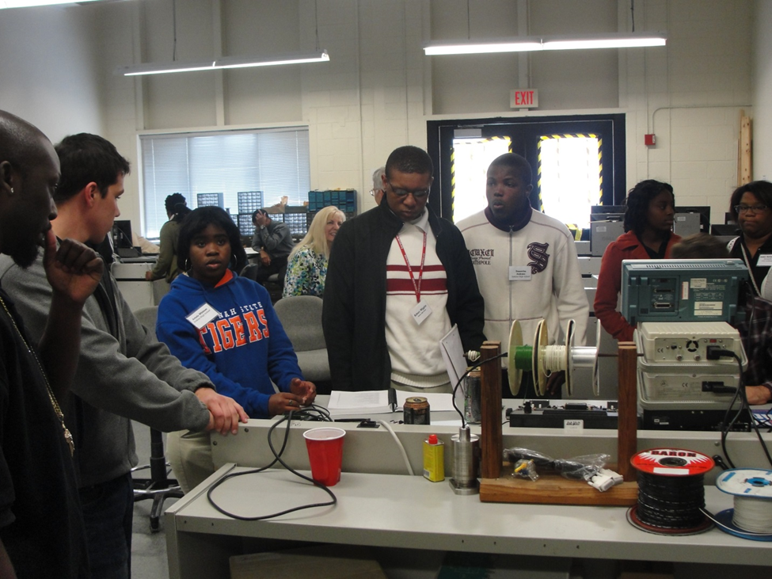
Savannah State University (HBCU)
PR Award: P031B120530
1005-113 STEM 360
High School Engineering Explorers Visit to SSU-2012

Slide 3
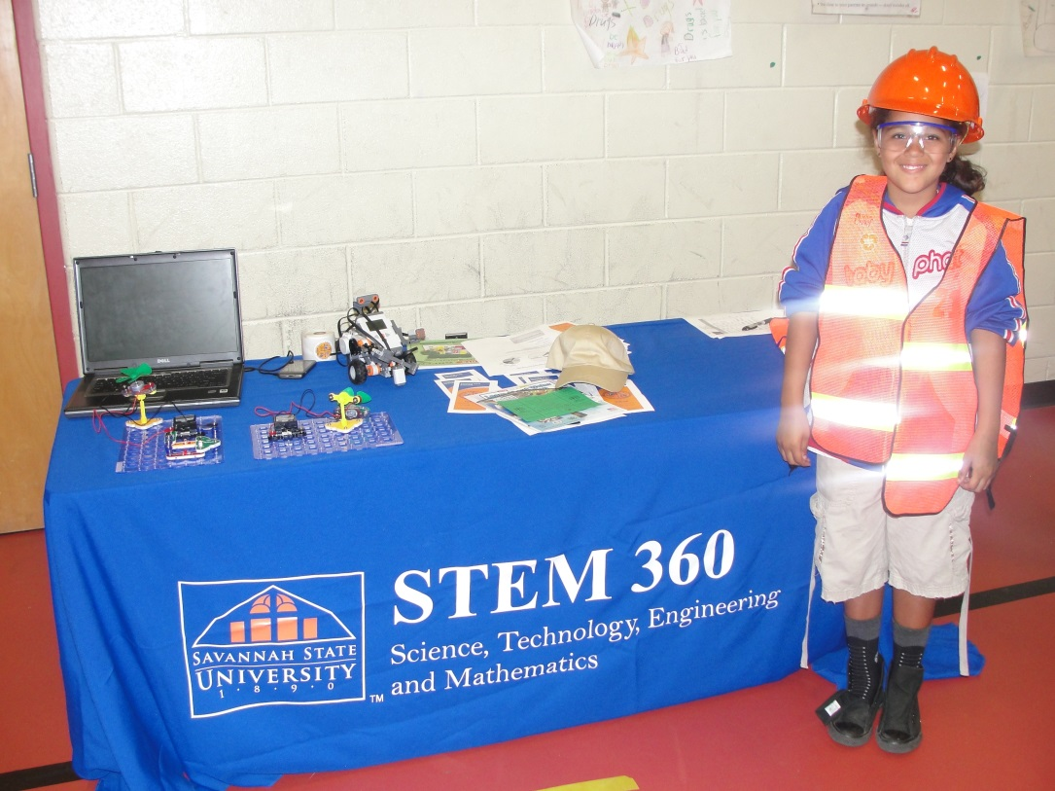
Savannah State University (HBCU)
PR Award: P031B120530
1005-113 STEM 360
STEM 360 Outreach-2013

Slide 4
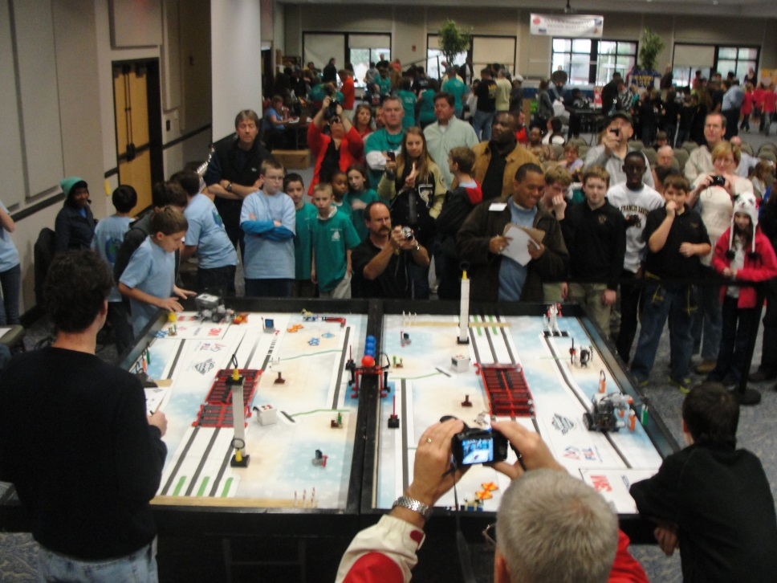
Savannah State University (HBCU)
PR Award: P031B070006
1010-512 STEM 360
2012 FIRST LEGO League Regional Qualifier

Slide 5
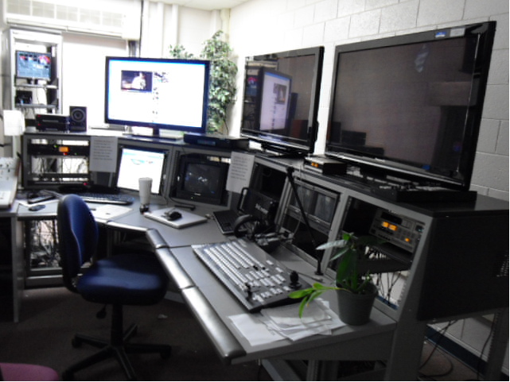
Savannah State University (HBCU-SAFRA)
PR Award: P031B100012
1303-13-48 Mass Communication: Student Media Center & Learning Laboratories
Media Center Editing Lab

Slide 6
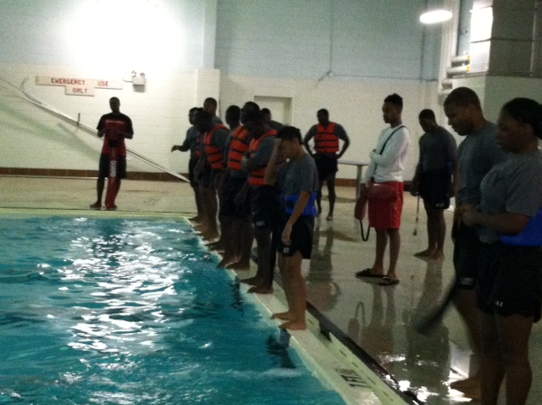
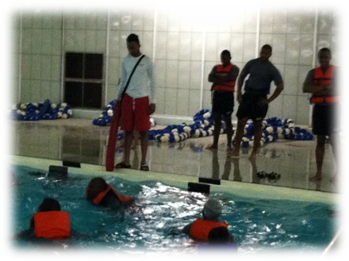
Savannah State University (HBCU-SAFRA)
PR Award: P031B100012
1305-13-48 Aqua Paws: Swimming Instruction Program
Swimming Class for ROTC-Fall 2012

Slide 7
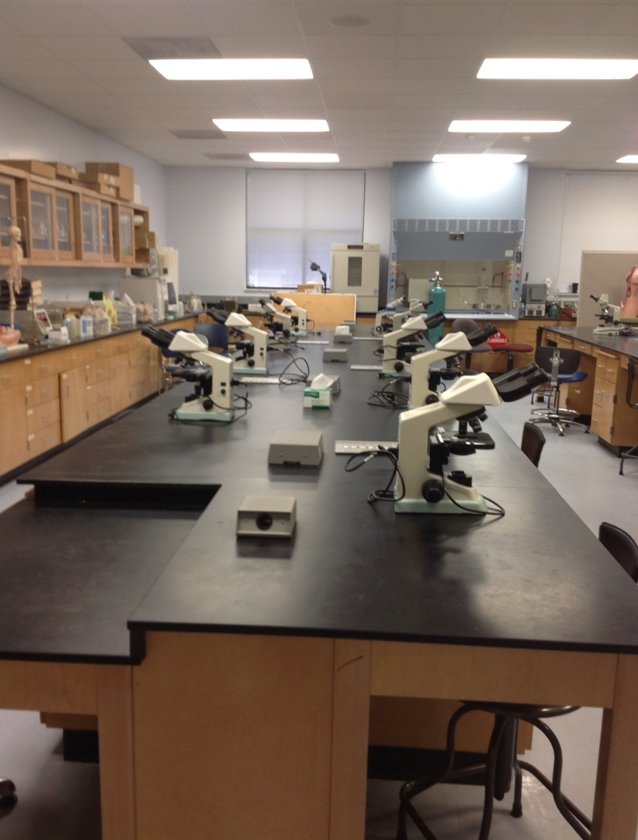
Savannah State University (HBCU)
PR Award: P031B120530
1009-113 Enhancing the School of Teacher Education Program
Biology Lab with Microscopes

Slide 8
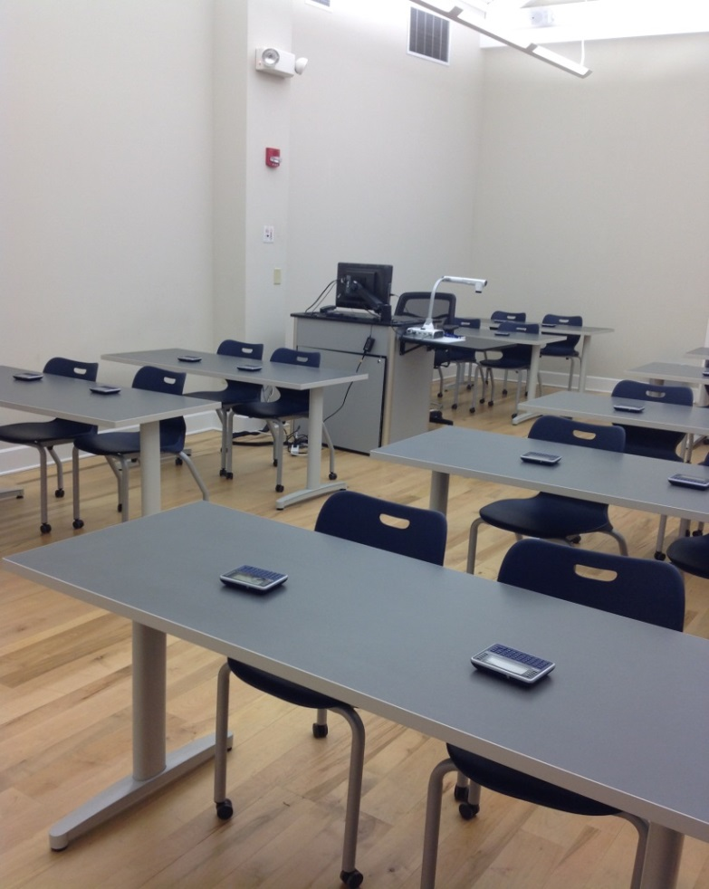
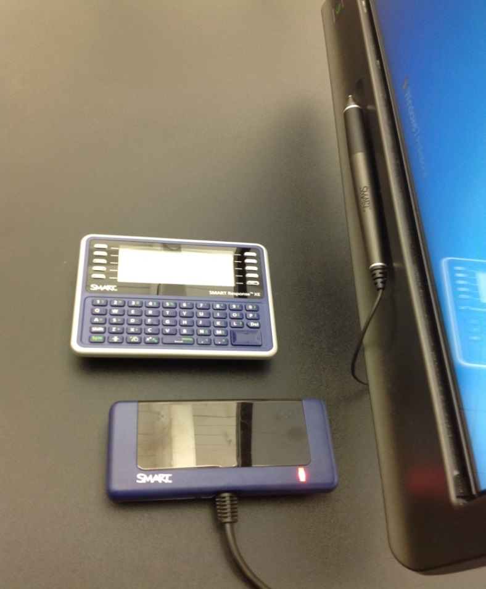
Savannah State University (HBCU)
PR Award: P031B120530
1009-113 Enhancing the School of Teacher Education Program
Smart Response System

Slide 9

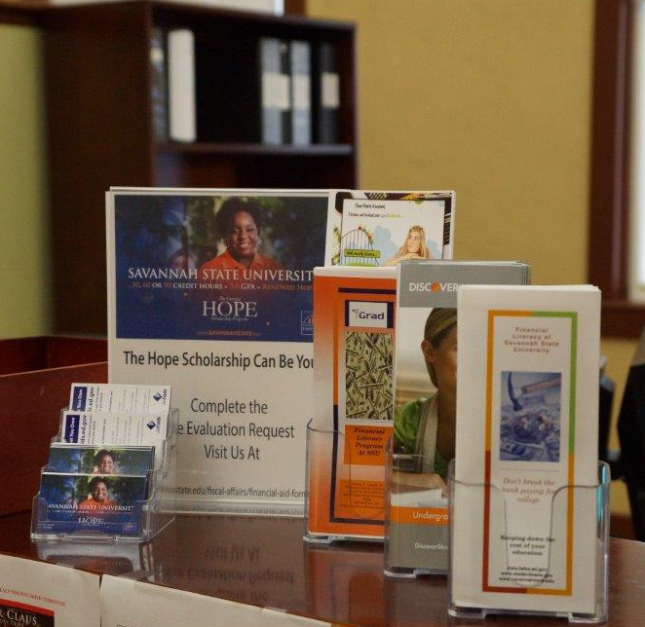
Savannah State University (HBCU)
PR Award: P031B120530
1011-113 Development of a Student Financial Literacy Program
Financial Literacy Workshop 2013

Slide 10
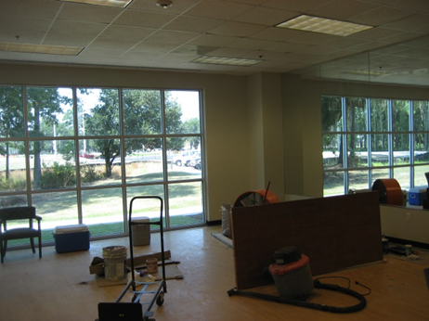

Savannah State University (HBCU)
PR Award: P031B100012
1014-512 Academic Building Enhancements
Athletic Study Hall-2012
(Tiger Arena)

