Slide 1
Litter isn’t Glitter: Beaches Should Be Clean
Some background information on litter, marine debris, and sampling techniques
Kelsey R. Cramer, Michele B. Sherman, and Mary Carla Curran*
Savannah State University
*for more information contact Dr. Curran at curranc@savannahstate.edu

Slide 2
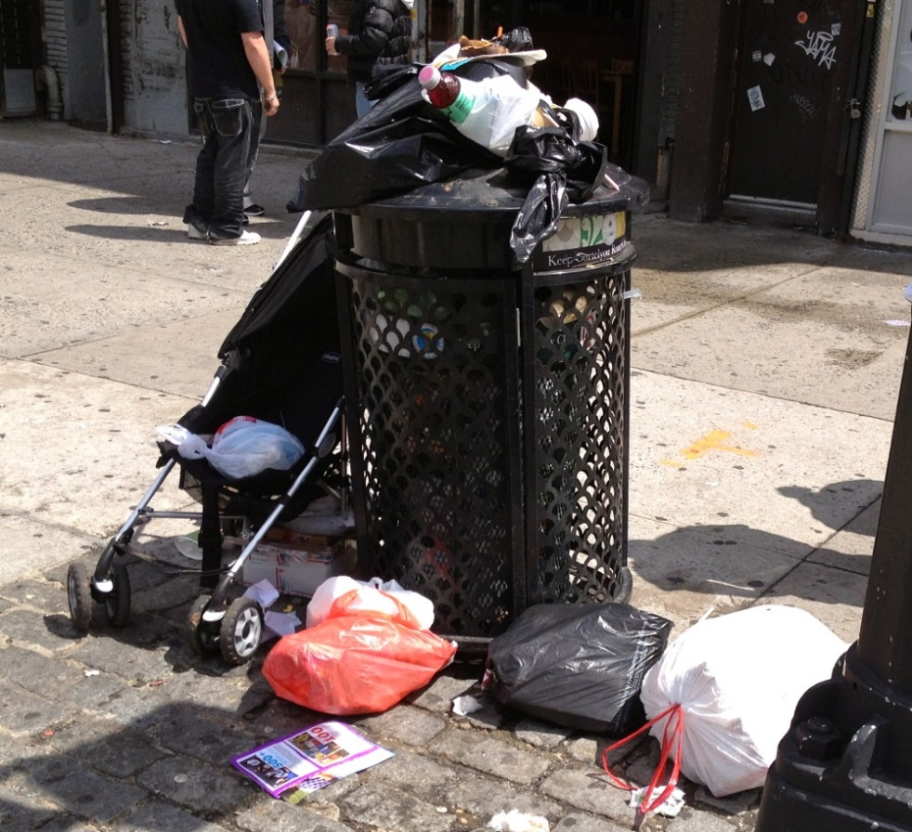
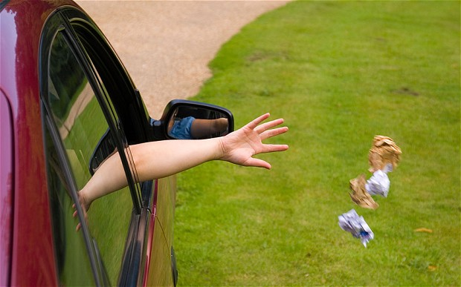
Trash that is not disposed of or recycled properly becomes litter.
Origins of Marine Debris
http://ditmasparkcorner.com
http://i.telegraph.co.uk

Slide 3
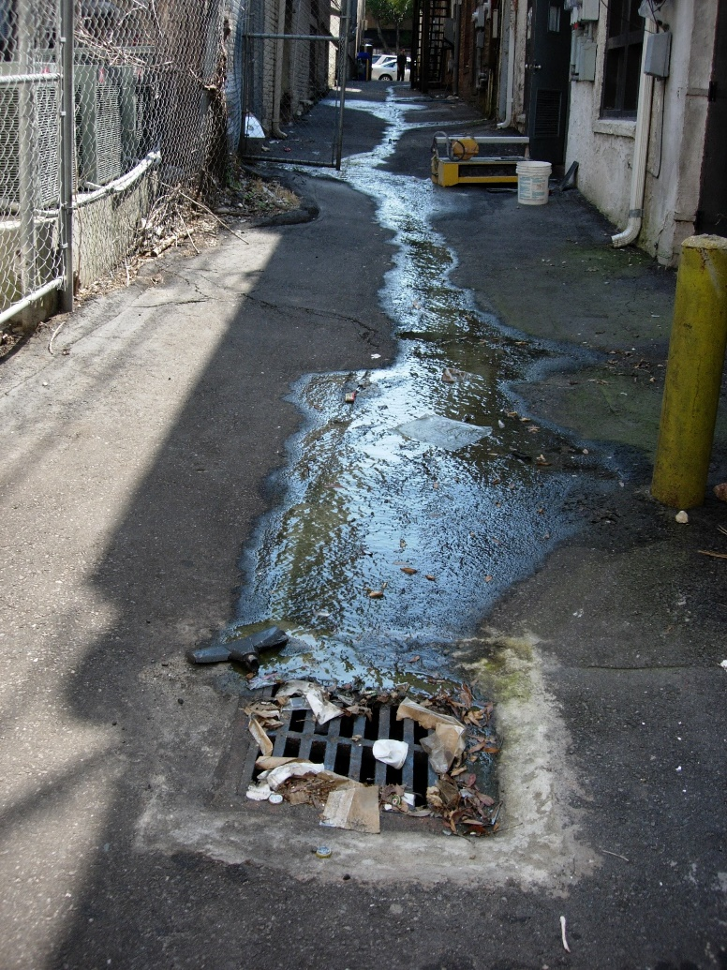
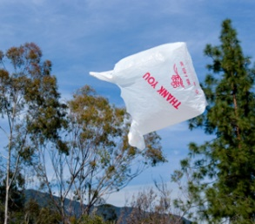
Litter becomes marine debris when it is carried into the oceans and waterways through wind, rain, and snowmelt (Sheavly and Register, 2007).
http://www.wilmingtonnc.gov
Storm drains, creeks, rivers, streams, lakes, and beaches are some of the paths that lead litter to the oceans.
http://www.rodalesorganiclife.com

Slide 4
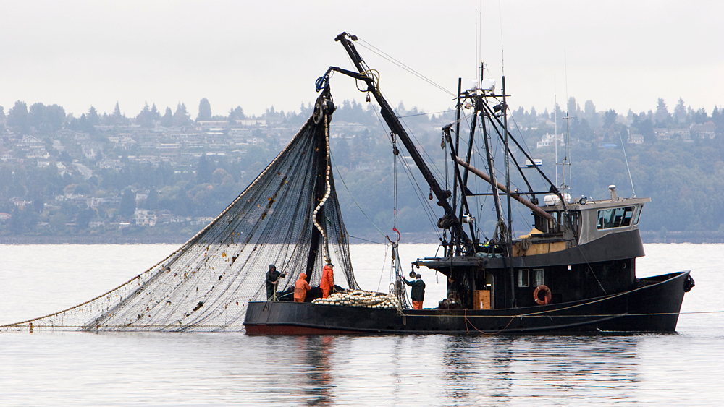
Litter may be directly introduced into the marine environment from
Boats
Jet skis
Commercial fishing and shipping vessels
Recreational boats
Other watercrafts (Sheavly and Register, 2007)
http://www.npr.org

Slide 5
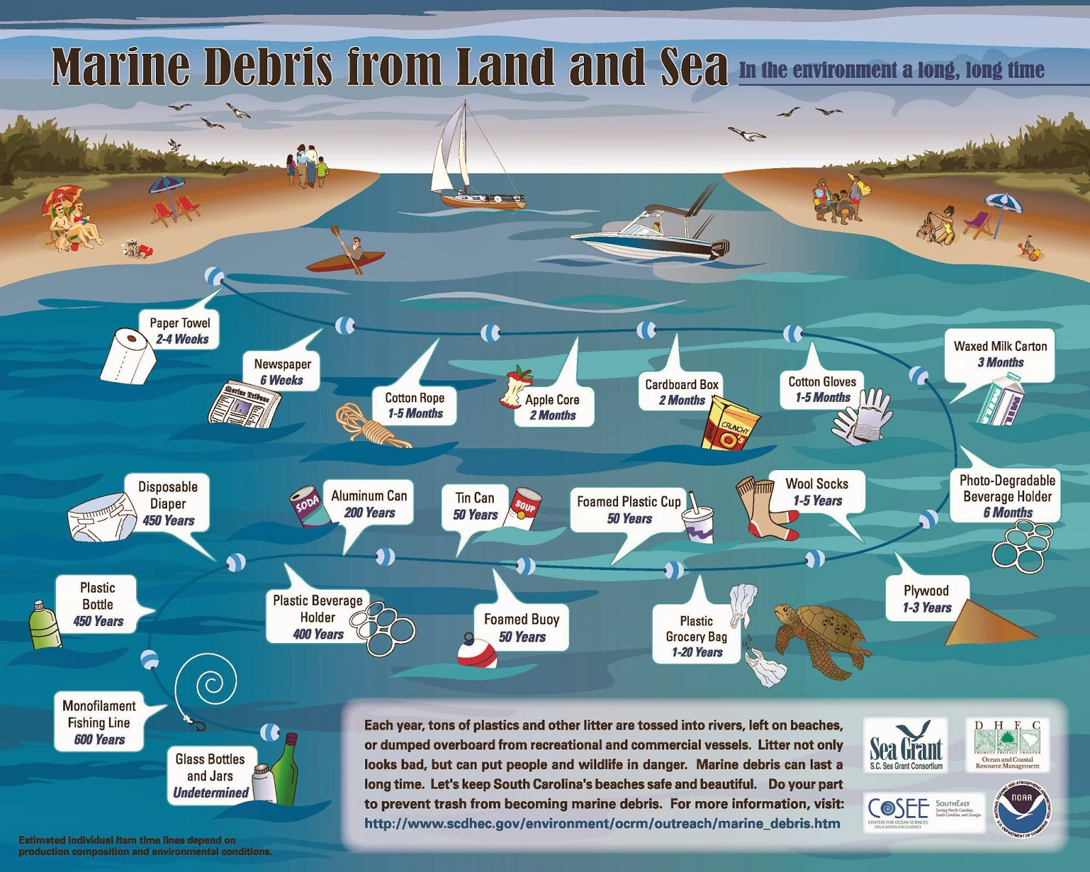
Quantifying the origins of marine debris is difficult due to the long distances that it travels (Sheavly, 2007).
49% of marine debris is from land-based sources, followed by 18% from ocean-based sources, and 33% from general sources meaning it cannot be classified as land- or water-based (Sheavly, 2007).

Slide 6
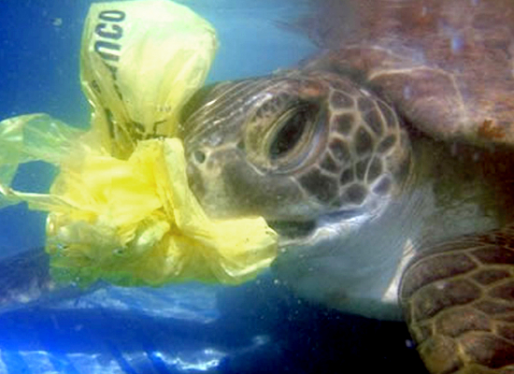
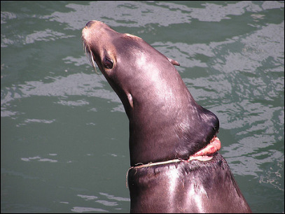
Negative Effects of Marine Debris on Animals
Entanglement in the debris can result in the inability of animals to eat or move freely (Sheavly and Register, 2007).
http://ecowatch.com
Ingestion of debris is very harmful to marine organisms and it happens frequently as a result of it being mistaken for food (Sheavly and Register, 2007).
http://media.kval.com

Slide 7
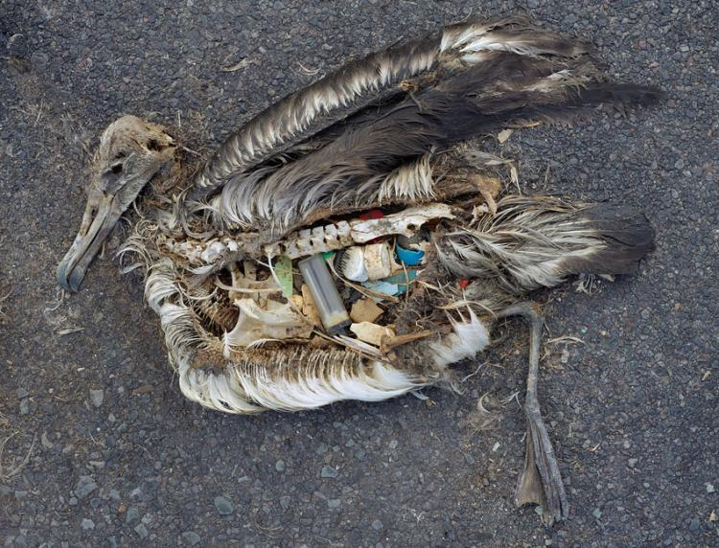
The debris may become stuck in the throat or digestive tract of animals which prevents them from eating and eventually leads to starvation (Sheavly and Register, 2007).
Ingested debris may also cause the animal to die as a result of toxicity from contaminants (EPA, 2012) that are associated with plastics.
http://ocean.si.edu Credit: Chris Jordan

Slide 8
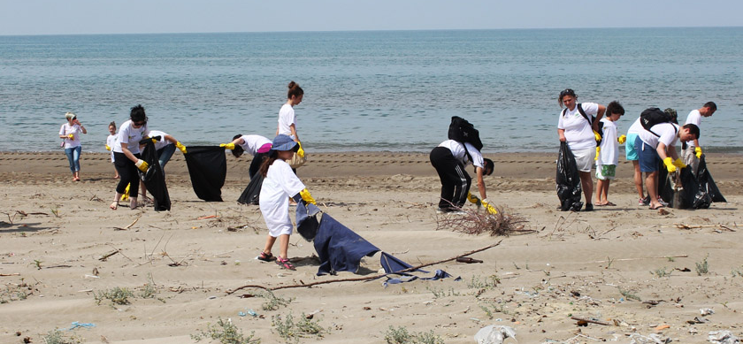
Efforts to reduce and understand marine debris
The Ocean Conservancy hosts the International Coastal Cleanup each year in efforts to remove litter from beaches (Ocean Conservancy, 2015).
http://president.al/?p=8628

Slide 9
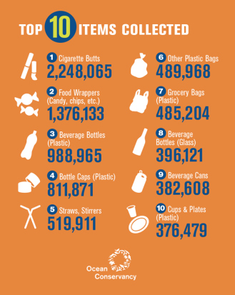
During the 2015 cleanup alone, more than 16 million pounds of litter were collected along 13,360 miles of coastline (Ocean Conservancy, 2015).
The most abundant item was cigarette butts. Food wrappers, plastic beverage bottles, plastic bottle caps, and plastic bags were also among the top 10 items collected (Ocean Conservancy, 2015).
https://marinedebrisblog.wordpress.com

Slide 10
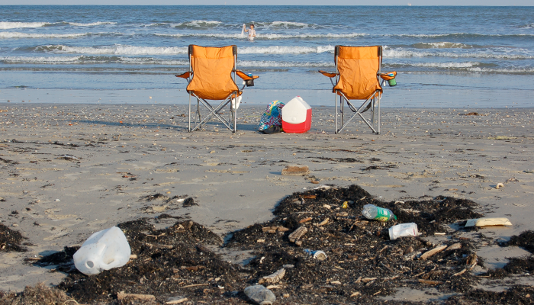
Litter on Beaches
The presence of litter on beaches is of great concern, as it can be washed or blown into the ocean and become marine debris.
http://www.glo.texas.gov

Slide 11
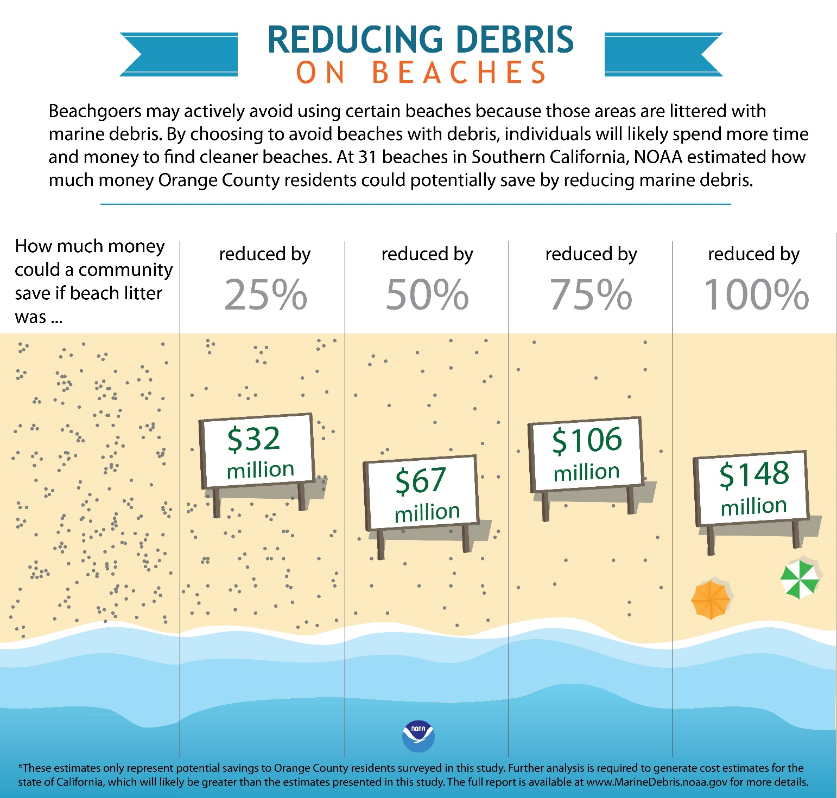
There are economic consequences as well. Litter on beaches can deter users from visiting, which could adversely affect the economy of towns that rely on tourism (Ballance et al., 2000).
In a study conducted in Cape Peninsula, South Africa, tourists frequently rated cleanliness as the most important factor when choosing a beach, and stated that they would travel at least 31 miles to visit a clean beach
(Ballance et al., 2000).
http://marinedebris.noaa.gov

Slide 12
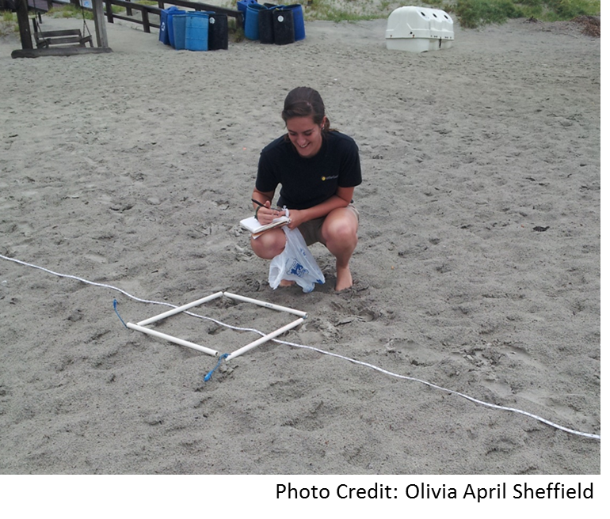
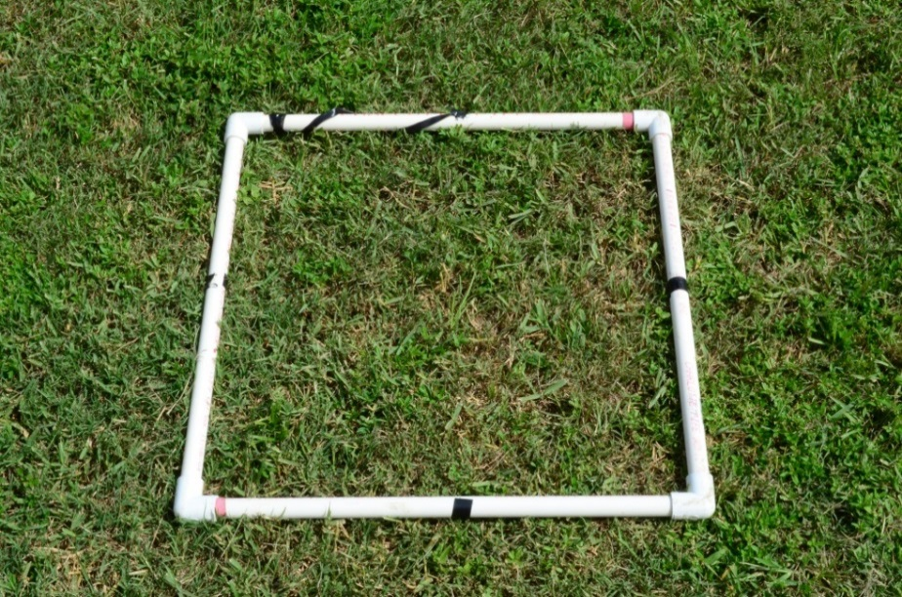
How is Litter on Beaches Assessed?
Litter surveys are often conducted using transect lines and quadrats. Transects are straight lines (made with ropes, measuring tapes, etc.) along which systematic observations or measurements are made. They are a good tool for determining linear trends along an environmental gradient,
such as seashore.
Quadrats (pictured on the right) are small plots used to isolate a standard unit of area from which the distribution of an object over a larger area can be estimated. They are used when an area is too large to sample entirely.
Photo Credit: Michele B. Sherman

Slide 13
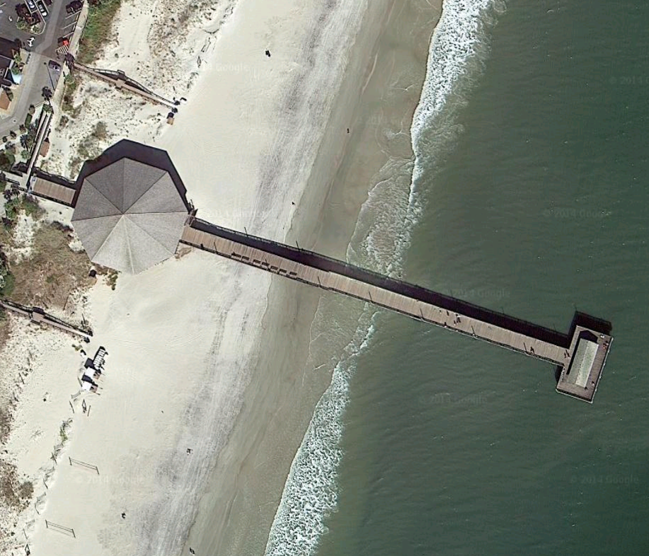
Litter Survey in Coastal Georgia in 2013
Study site was an area of a beach in coastal Georgia that seemed to receive more visitors than any other area of the ~7 km long beach.
Sampling occurred 12 times from May-August 2013.
Google Maps

Slide 14
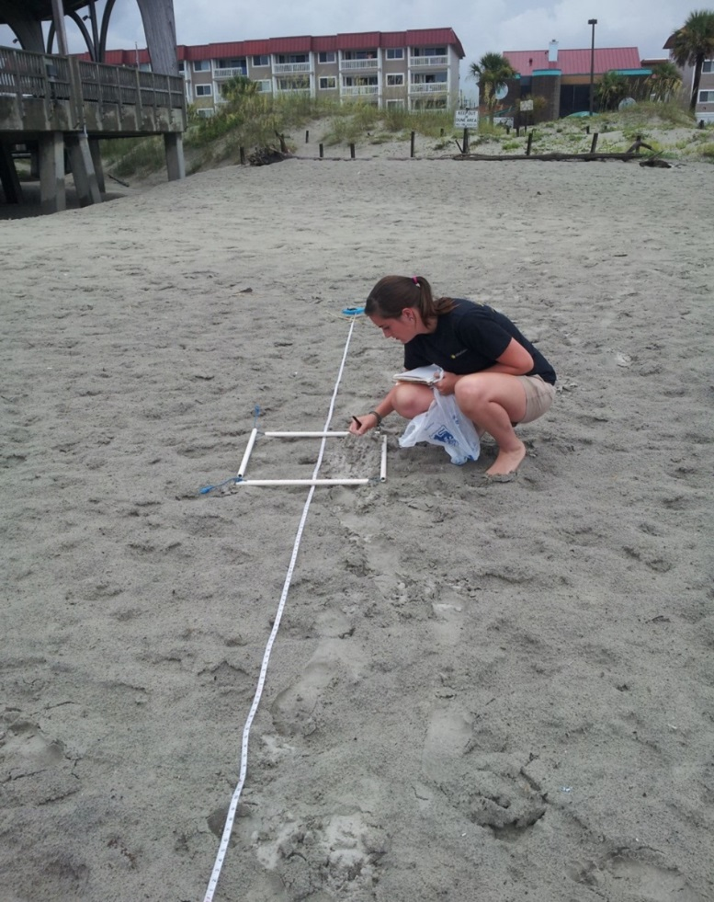
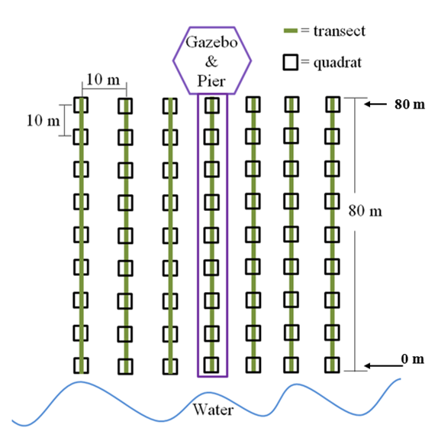
Each survey consisted of 7 transects (80 m long) that ran perpendicular to the water.
A 0.5 m x 0.5 m quadrat was placed along each transect every 10 m.
Photo Credit: Olivia April Sheffield
The litter inside each quadrat was counted, categorized, and then disposed of properly.
Trends were established after all data were collected.

Slide 15
Now it is your turn to give it a try!
Go out and see what you can come up with using the same methods that you just learned about.

Slide 16
References
Ballance, A., P.G. Ryan, and J.K. Turpie. 2000. How much is a clean beach worth? The impact of litter on beach users in the Cape Peninsula, South Africa. South African Journal of Science 96:210-213.
EPA. 2012. Marine debris impacts. Available online at h http://water.epa.gov/type/oceb/marinedebris/md_impacts.cfm
Ocean Conservancy. 2015. International coastal cleanup: 2015 trash free seas report, by the numbers. Available online at http://www.oceanconservancy.org/our-work/international-coastal- cleanup/2015-by-the-numbers.html
Sheavly, S.B. and K.M. Register. 2007. Marine debris and plastics: Environmental concerns, sources, impacts, and solutions. Journal of Polymers and the Environment 15:301-305.

